Slide 1
MassMutual DSDP 2018: Introduction to Data Visualization
June 15, 2018
R. Jordan Crouser
Assistant Professor of Computer Science
Smith College

Slide 2

Introductions & background
Jordan
(he / him)
2017 on: Asst. Prof. in CS (Smith)
2015 to 2017: Visiting Asst. Prof. in SDS (Smith)
2013 – 2015: Research Scientist (MITLL)
2010 – 2013: PhD in Visual Analytics (Tufts)
2008 – 2010: MSc in Educational Tech. (Tufts)
2004 – 2008: BA in CS and Math (Smith)
For more info, visit:
www.science.smith.edu/~jcrouser

Slide 3
Some housekeeping
Workshop website:
jcrouser.github.io/MassMutual-DataVis
Rough structure:
6 modules over 3 days (AM and PM)
Intro → Walkthrough/Lab → Explore → Share
Assumptions:
R/Rstudio installed
Basic proficiency in R

Slide 4
Learning objectives
1. Understand
why data vis works
(and doesn’t)
2. Explore some
foundational
methods / tools
3. Opportunities to
get to know
your new team

Slide 5





What I do: analytical tools for messy data

Slide 6
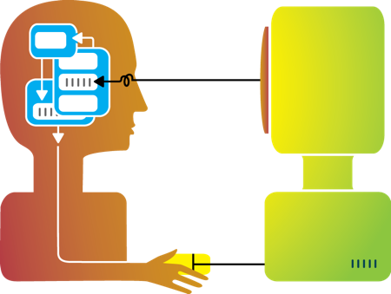
Big idea behind my research
Humans and machines have complimentary strengths
Visualization
Perception
and
context
Interaction
Computational power
Image credit: Ali Ansari

Slide 7
Focus of this workshop
How do we build visualizations that help humans understand patterns in data?
Visualization
Image credit: Ali Ansari

Slide 8
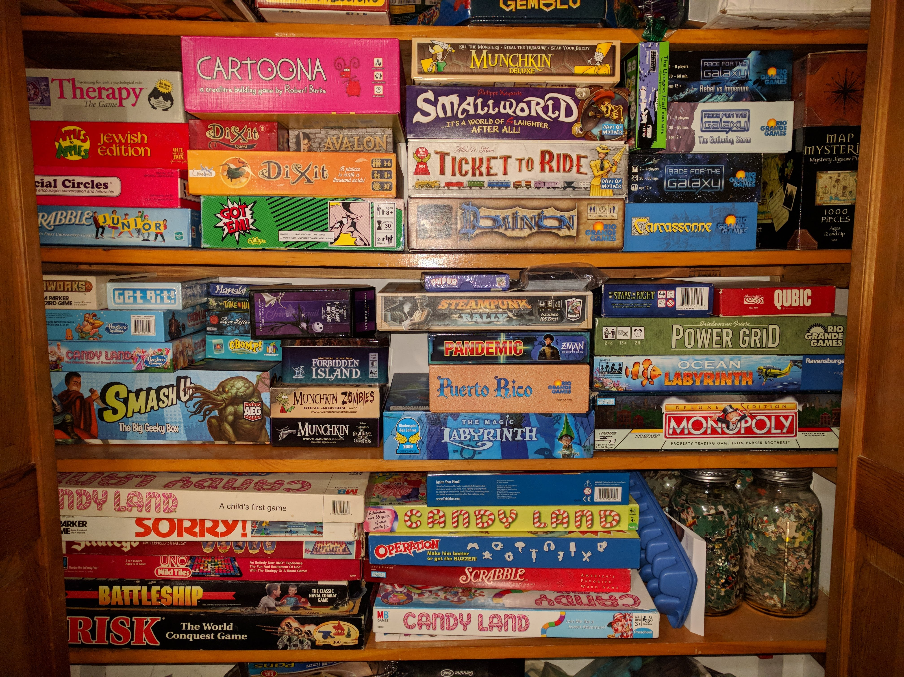
Interesting (non-CS) thing to know about me
I’m a big
board game
nerd
(we have a closet
in our house
dedicated to them)
Notes:
18 coral
12 bony fish
10 invertebrates
8 anemone
4 sponge
3 copepods

Slide 9

Way more interesting thing
“…I might come to visit later this summer,
I have lots of thoughts on data vis!”
Logan
(10 months old)

Slide 10
3-minute biographies
About you:
Your name and pronouns
Your alma mater
Your major / area of focus
3 questions:
What brought you to DSDP?
What’s one big thing you hope to get out of it?
What's one thing about life after graduation that you find particularly challenging / anxiety-provoking?
-or-
What’s one thing about you that would probably surprise us?

Slide 11
Outline
Introductions
Visualization overview
Flashback to early experiences in data wrangling
Visualization (def.)
Data (def.)
Quick history lesson
Graphical primitives
Visual dimensions
Pre-lunch activity: deconstructing data graphics
After lunch: ggplot2 crash course

Slide 12
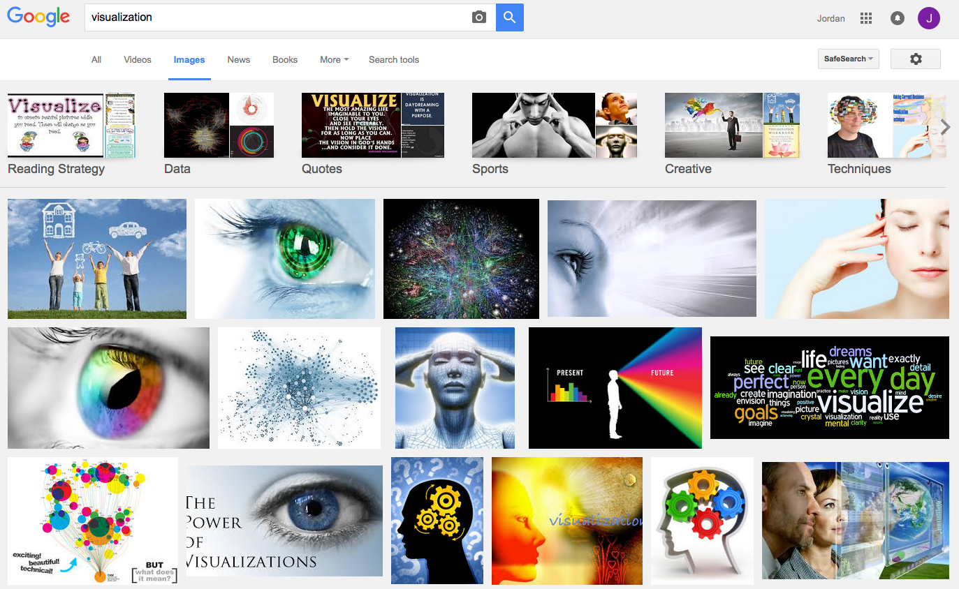
What is visualization?

Slide 13
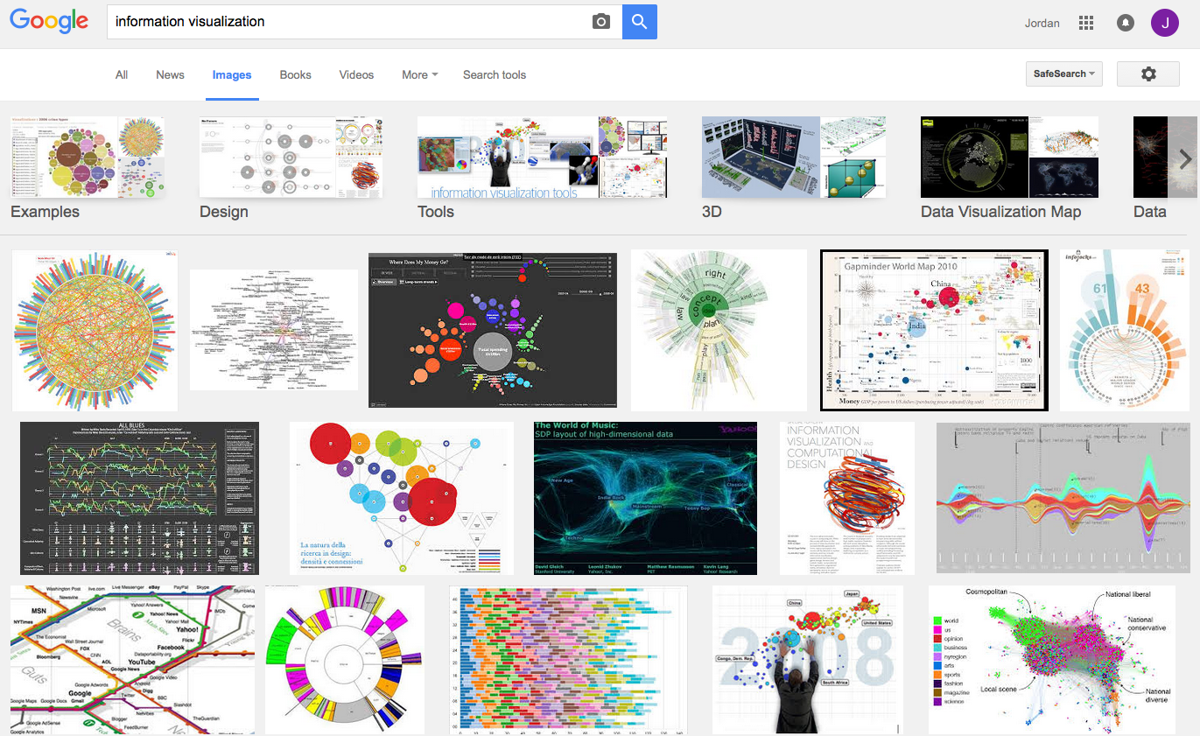
What is visualization?

Slide 14
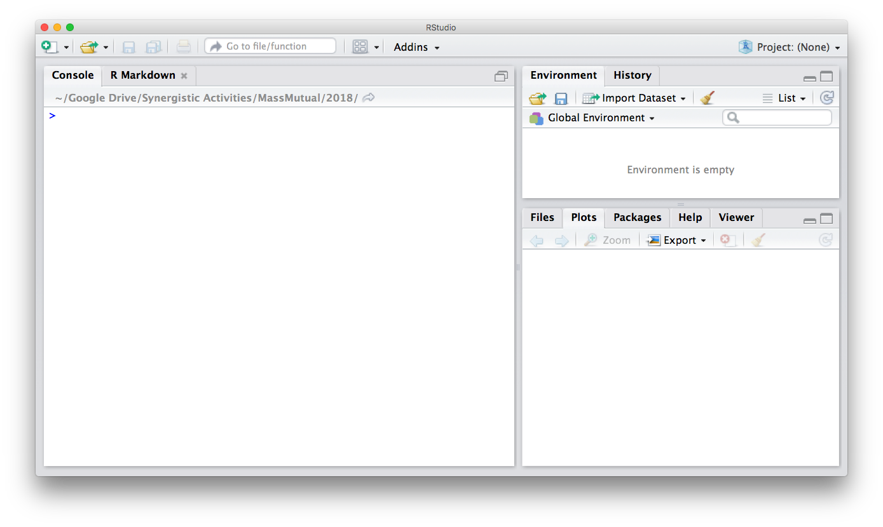
Flashback…

Slide 15
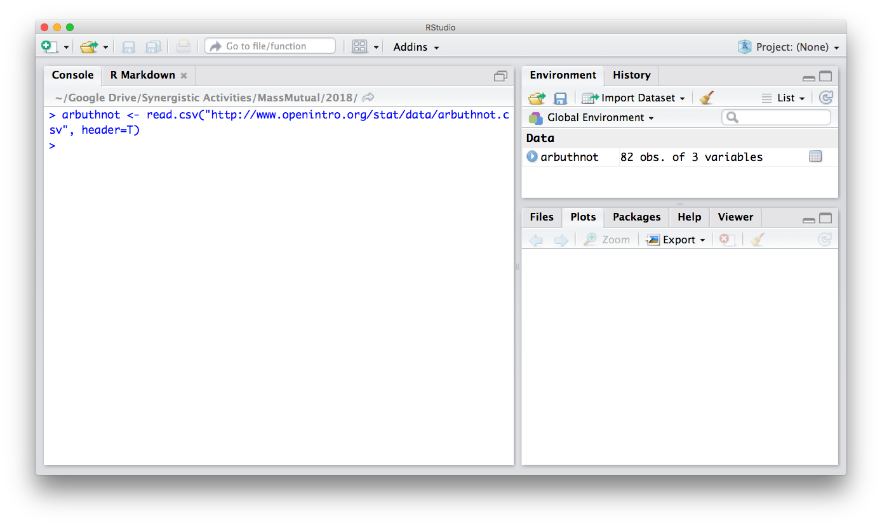
Flashback…

Slide 16
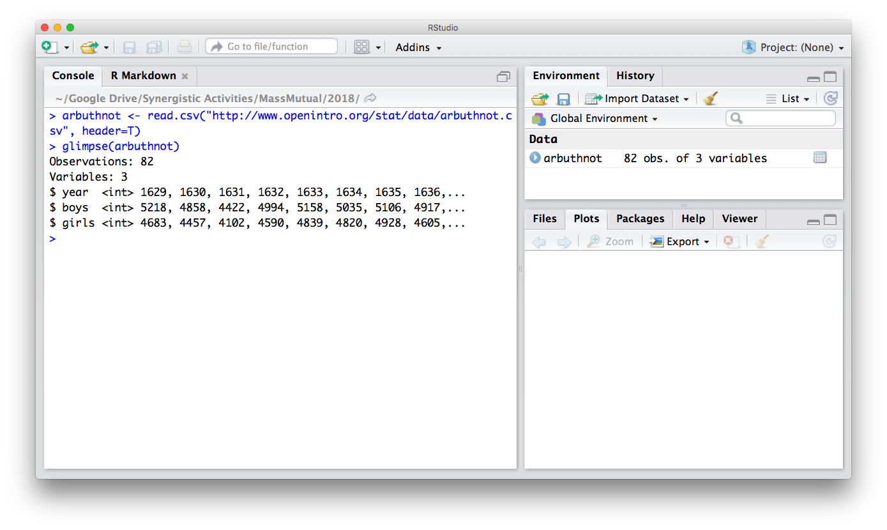
Flashback…

Slide 17
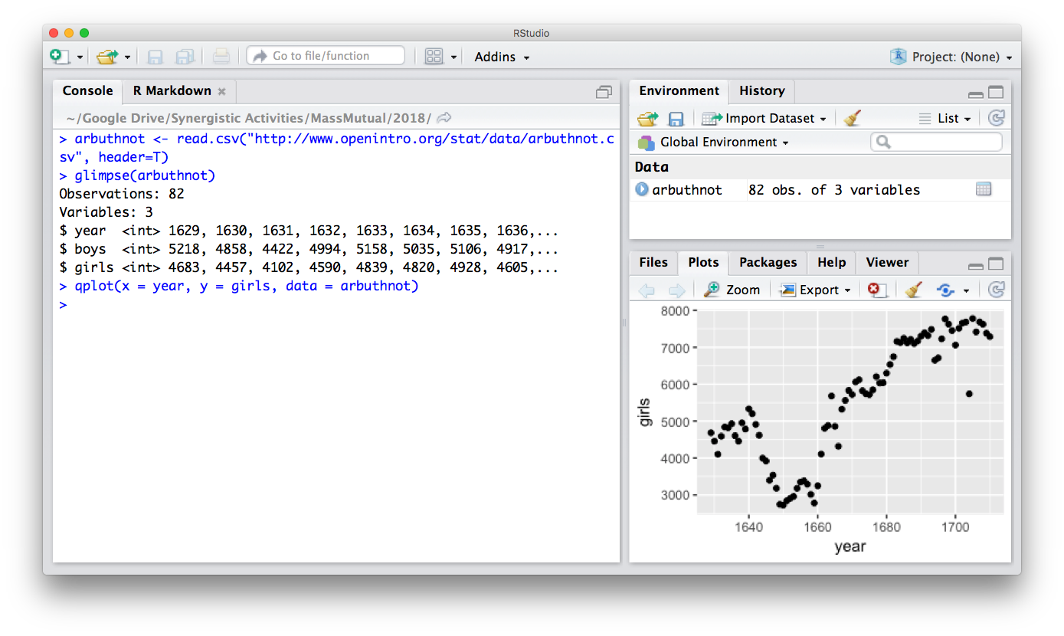
Flashback…

Slide 18
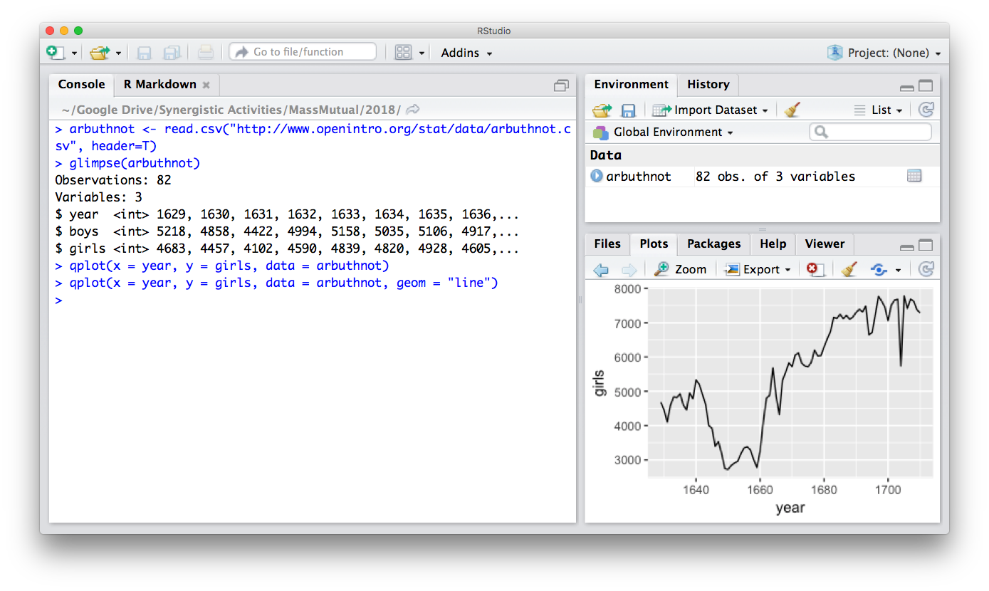
Flashback…

Slide 19

Question
What makes these
“visualizations” useful?

Slide 20
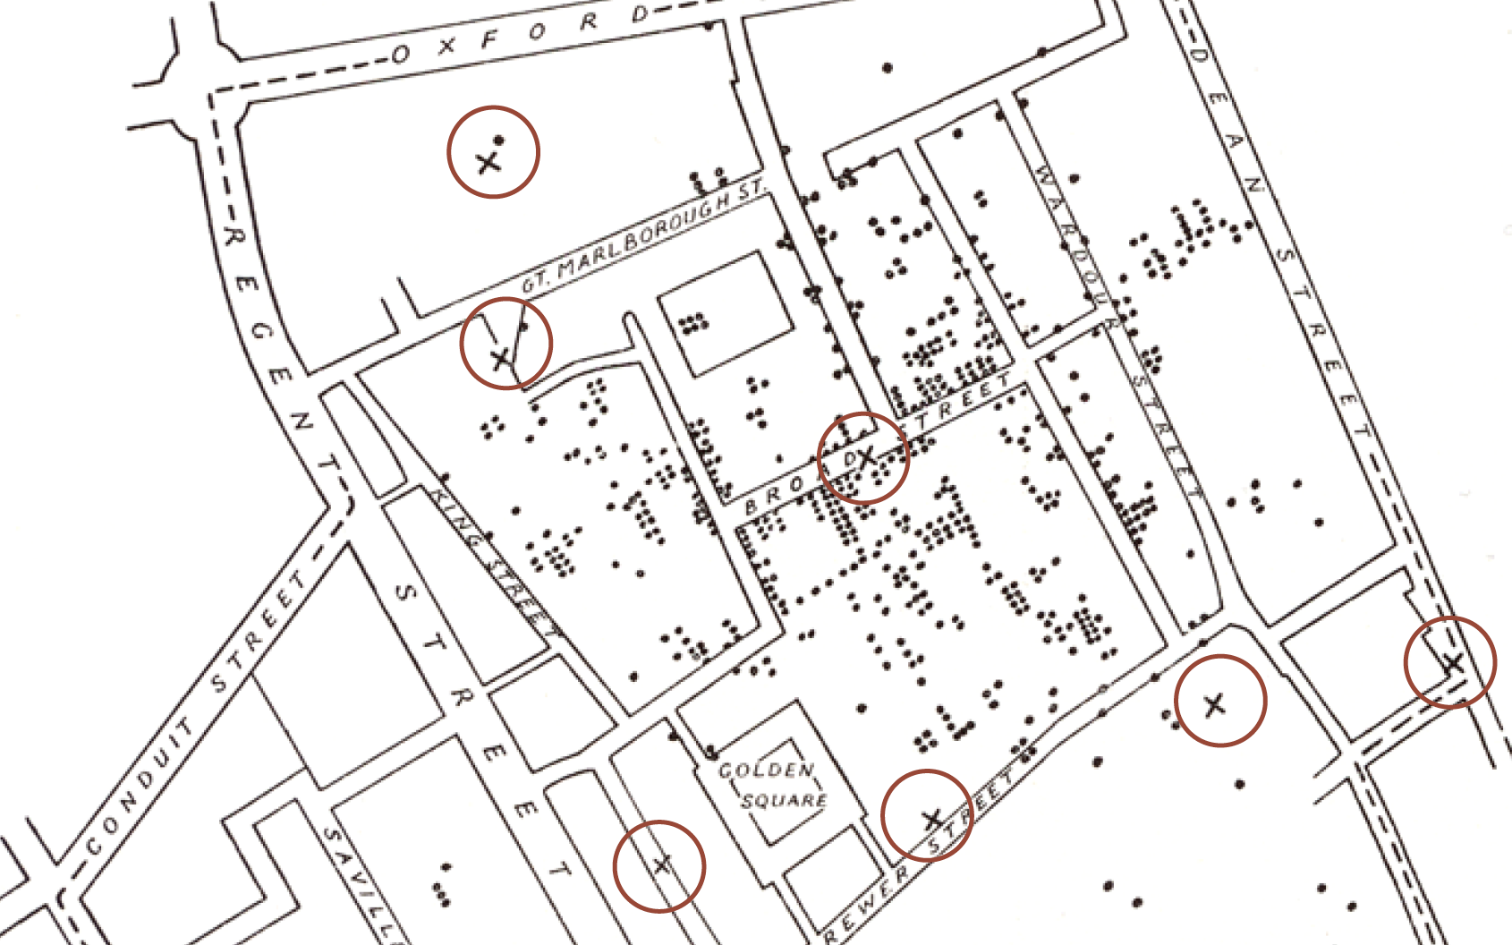
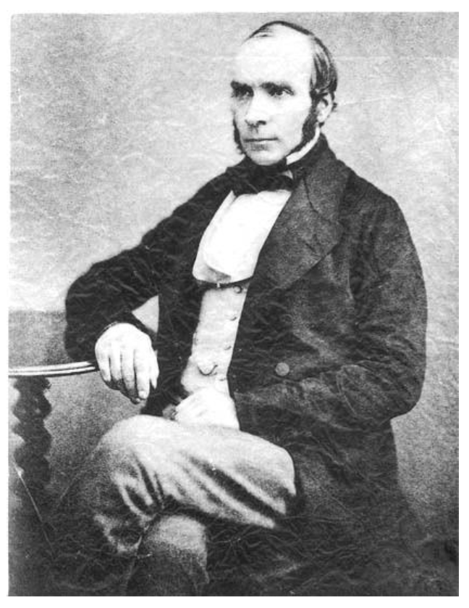
Do they help you spot trends?
In 1854, cholera broke out in London
127 people near Broad St. died within 3 days
616 people died within 30 days
Initial explanation:
“Miasma in the atmosphere”
Dr. John Snow was the first to link the outbreak to contaminated water
How did he do it?
Talked to local residents
Identified a water pump as a likely source
Used maps to illustrate his theory
Convinced authorities to disable the pump
More info here: http://en.wikipedia.org/wiki/1854_Broad_Street_cholera_outbreak

Slide 21
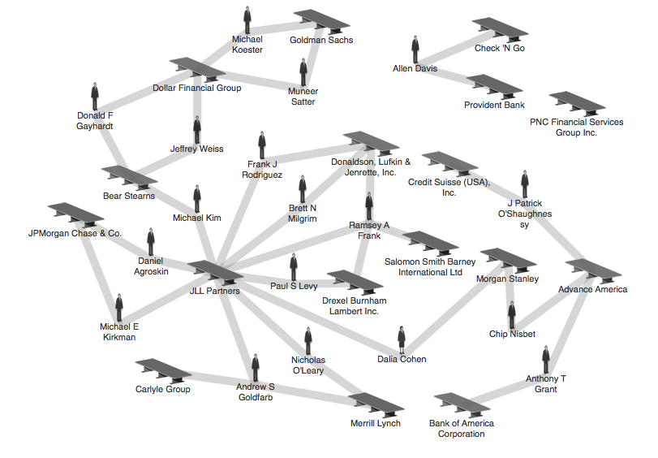
Do they help you explore?
Credit: theyrule.net

Slide 22

Do they tell a story?
Hans Rosling’s 200 Countries, 200 Years, 4 Minutes – The Joy of Stats – BBC Four
https://www.youtube.com/watch?v=jbkSRLYSojo

Slide 23
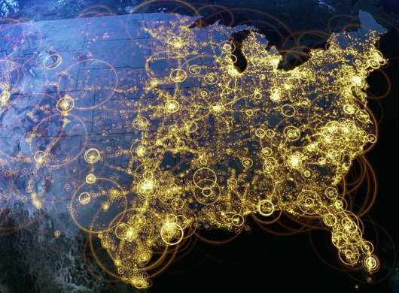
Visualization (def.)
Visual representations of data that reinforce human cognition
Notes:
Image from StackOverflow: http://i.stack.imgur.com/hbO8v.jpg

Slide 24

Data (def.)
a set of variables that capture various aspects of the world:
Tuition rates,
enrollment numbers,
public vs. private, etc.

Slide 25

Data (def.)
and a corresponding set of observations (a.k.a. records) over these variables. For example:
tuition = $46,288,
enrollment = 2,563,
private, etc.

Slide 26
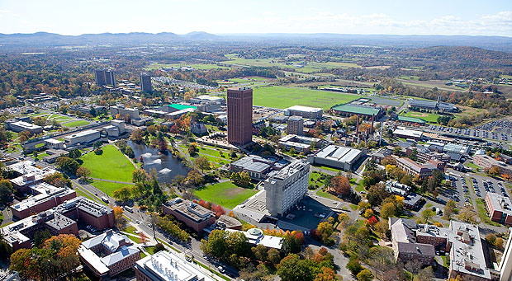

Data (def.)
and a corresponding set of observations (a.k.a. records) over these variables. For example:
tuition = $16,115,
enrollment = 28,635,
public, etc.

Slide 27
One way to think about this:
VARIABLES
 | Tuition | Enrollment | Public vs. Private | …
Smith College | $46,288 | 2,563 | private
UMass Amherst | $16,115 | 28,635 | public
Hampshire College | $48,065 | 1,400 | private
Mount Holyoke College | $43,886 | 2,189 | private
Amherst College | $50,562 | 1,792 | private
⋮
OBSERVATIONS

Slide 28
Why is this important?
Data have dimensions
Visualizations have dimensions, too
To build visualizations, we need to map data dimensions to visual dimensions

Slide 29
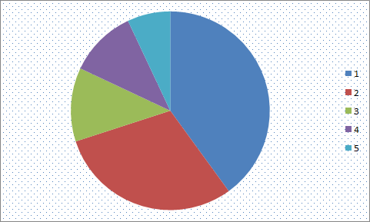
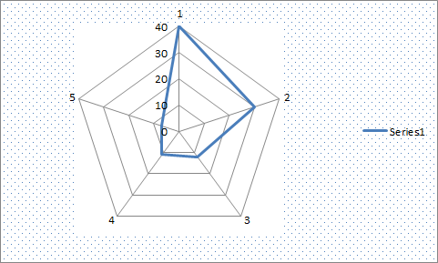
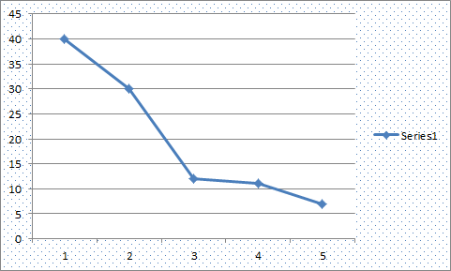
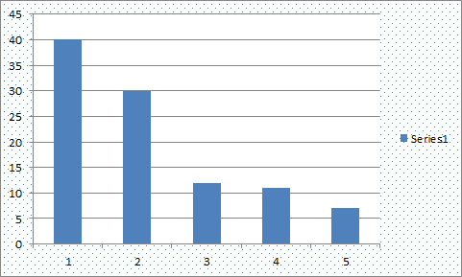
Key question for this workshop
Which data dimension should be mapped
to which visual dimension?

Slide 30
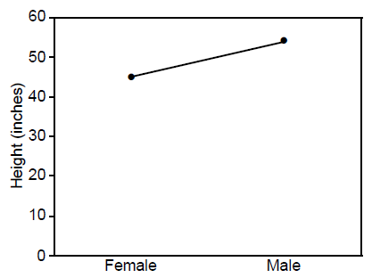
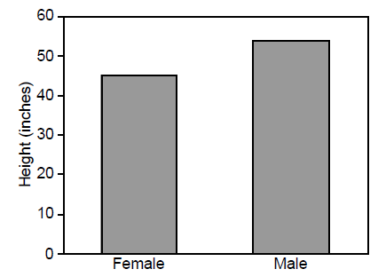
Answer: it depends
Average Height for Youth Sports Participants
Crew Basketball
Crew Basketball

Slide 31

A quick history lesson…

Slide 32
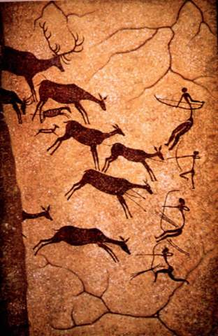
(Incomplete) History of Visualization: 15,000BC
15,000 BC. Laxcaux, France

Slide 33
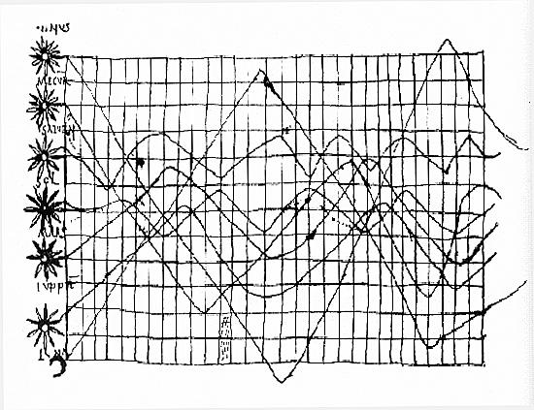
(Incomplete) History of Visualization: 900s
“De cursu per zodiacum”, illustrator unknown
Notes:
Oldest known attempt to show changing values graphically
Inclinations of the planetary orbits over time
An handwritten appendix in the back of a copy of Macrobius' Commentary on Cicero's Somnium Scipionis sitting in a library in Munich.

Slide 34
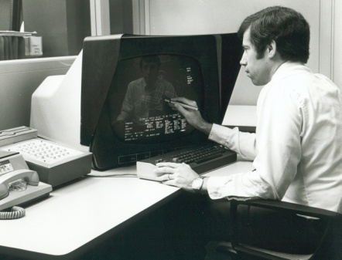
(Incomplete) History of Visualization: 1970s
CAD/CAM, building cars, planes, chips
Starting to think about: 3D, animation, edu, medicine

Slide 35
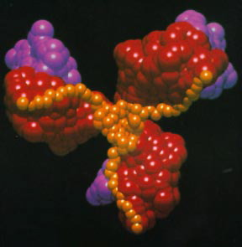
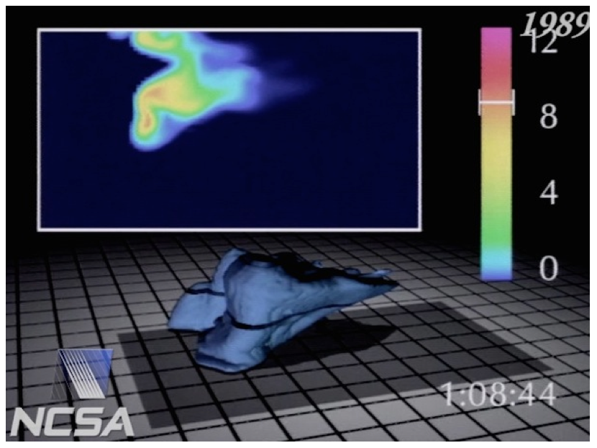
(Incomplete) History of Visualization: 1980s
Scientific visualization, physical phenomena
Starting to think about: photorealism, entertainment

Slide 36
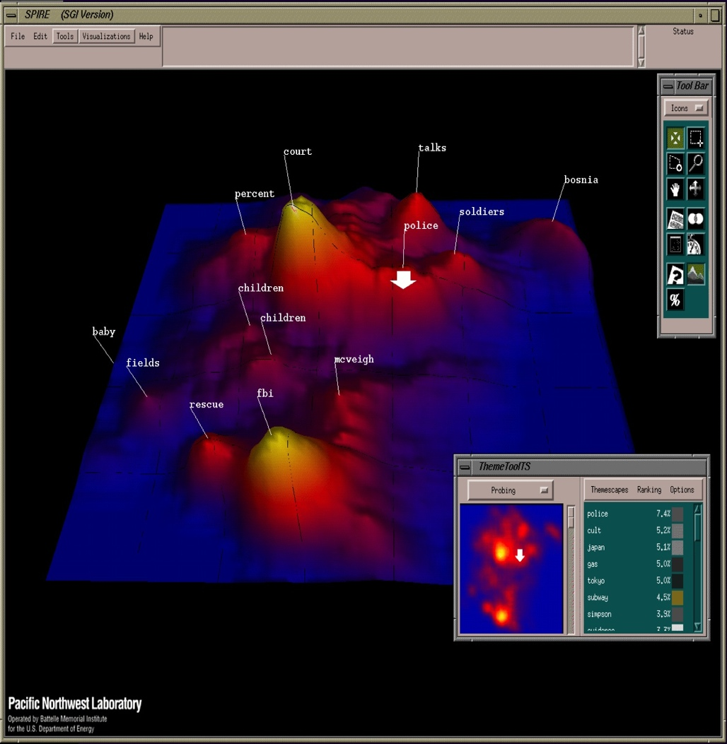
(Incomplete) History of Visualization: 1990s
Information visualization, storytelling
Starting to think about: online spaces, interaction

Slide 37
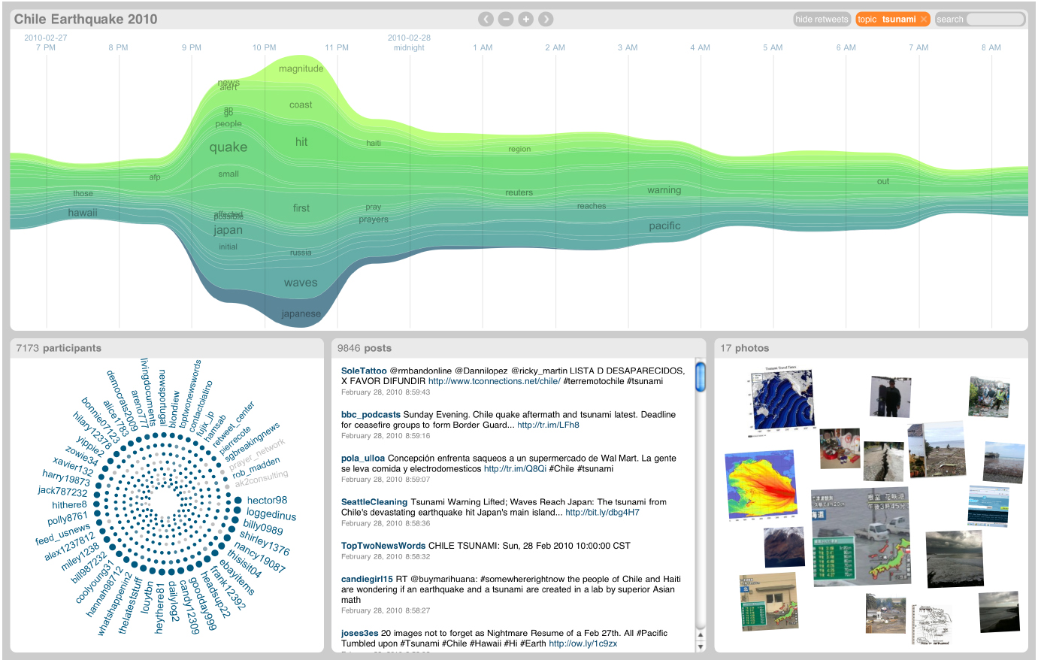
(Incomplete) History of Visualization: 2000s
Coordination across multiple views, interaction
Starting to think about: sensemaking, provenance

Slide 38
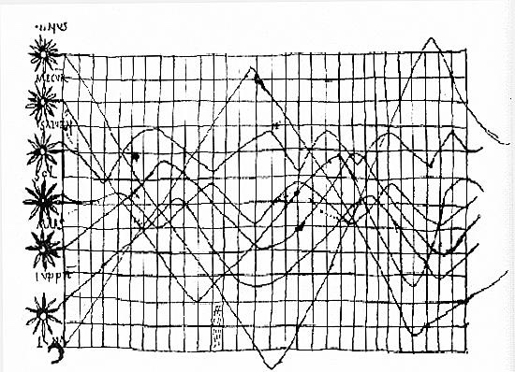
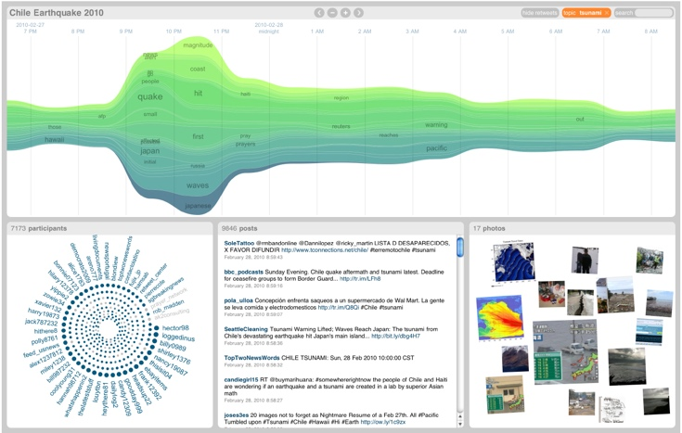
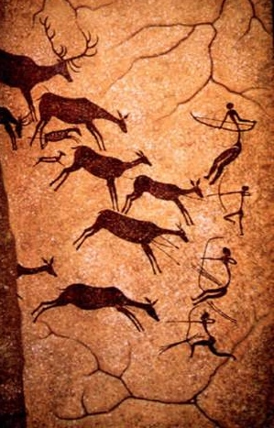
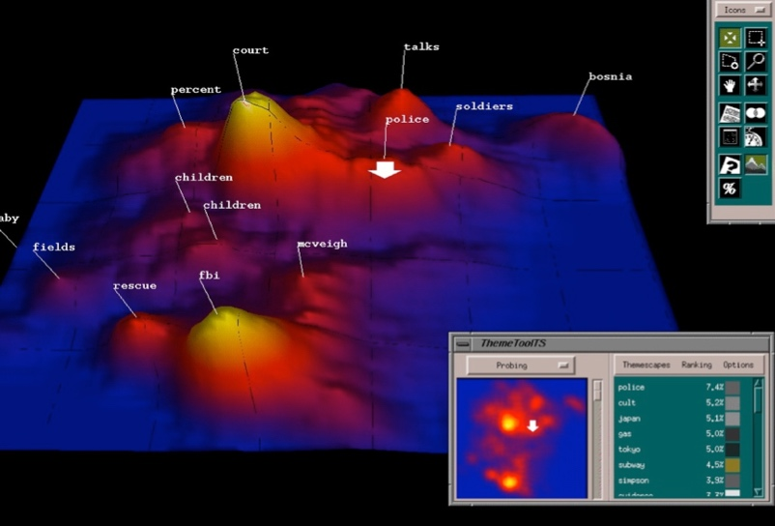
Discussion: what are they all trying to do?

Slide 39

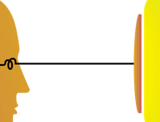

Visualization helps shape mental models
Visualization

Slide 40
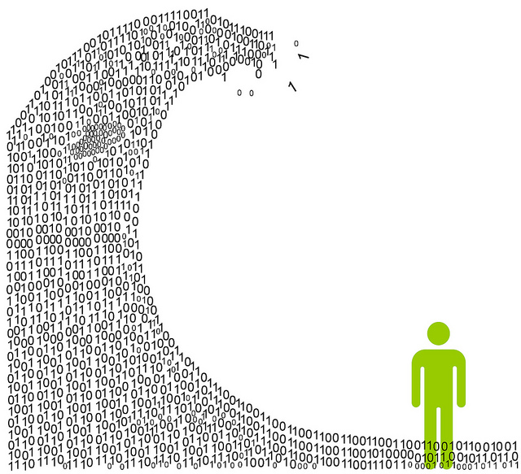
Information overload
We are exposed to huge amounts of information all the time
So much, in fact, that we can’t process it all fast enough

Slide 41

Mental models
To cope, we construct mental models: abstracted, simplified versions of the world that are more manageable

Slide 42



Mental Models: a Sketch

Slide 43
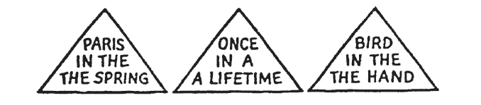
1. We tend to see what we expect to see
Notes:
Mental models are built from prior experience
We expect new input to “fit” the existing model
Updates are expensive: given input that almost fits, we’ll distort information to avoid re-fitting the model
Expectation is at least as strong as perception

Slide 44
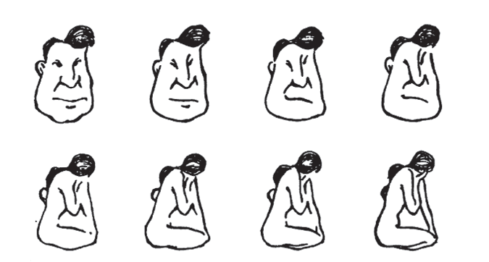
2. Mental models form quickly, & update slowly
Notes:
“First impressions matter”
Early information can have the highest impact
The order in which we present pieces of information can shape how a person understands the whole
Once a mental model is formed, it takes effort to alter it

Slide 45
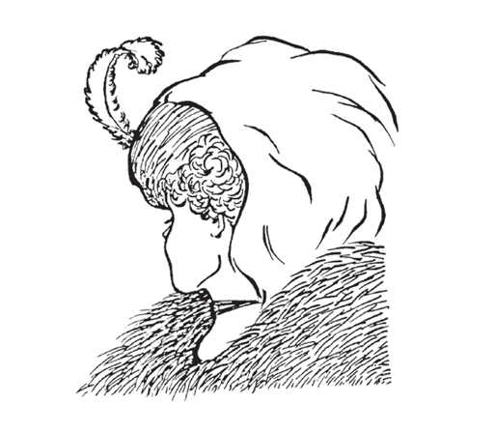
3. New information gets incorporated into the existing model
Notes:
Integrating competing perspectives is challenging
Switching between multiple perspectives is also difficult (visually or mentally)
Tricky part: real-world problem often require such perspective switching

Slide 46
4. Initial exposure interferes with accurate perception
Blur size
128px
64px
32px
16px
8px
None
Notes:
Longer exposure to ambiguous data makes people more confident in their initial model
This is true even if new data presents strong evidence that their model is wrong!
Important: need to be intentional when we design, because incremental information can be misleading

Slide 47
The good, the bad, and the ugly…
The good:
Well-tuned mental models let us process information quickly
Frees up more processing power to synthesize information
The bad:
People (esp. experts) tend not to notice information that contradicts their mental model
A “fresh pair of eyes” can be beneficial
The ugly:
Mental models are unavoidable: everyone has them, and they’re all different
Key: be aware of how mental models form, how they shape perception, and how to support (or challenge) them

Slide 48
So what do we have to work with?
Image credit: Ali Ansari

Slide 49

Graphical primitives
The images we draw are composed of marks: like ink
Lines
Points
Areas

Slide 50
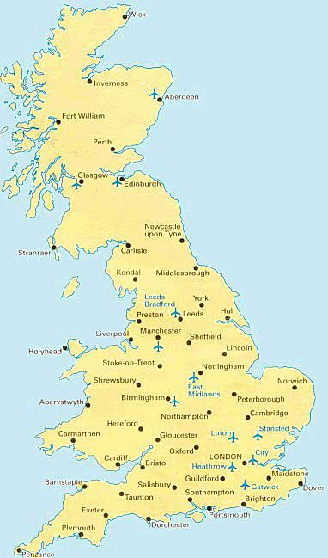
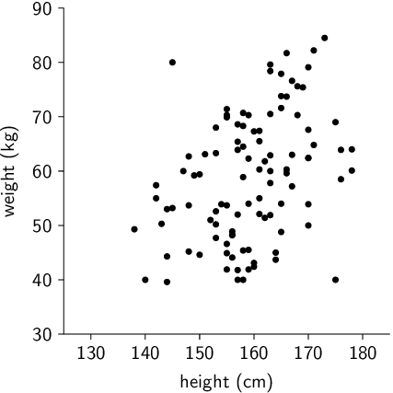
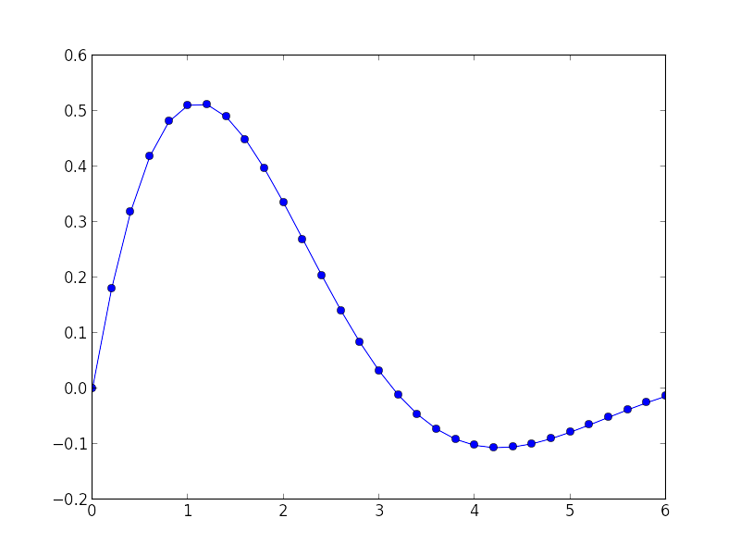
Visual dimension: position
Encode information using where the mark is drawn
Some examples:

Slide 51
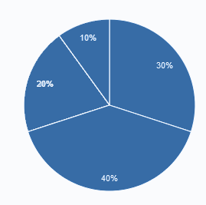
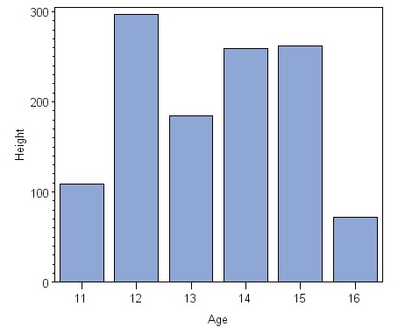
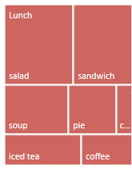
Visual dimension: size
Encode information using how big the mark is drawn
Examples:

Slide 52
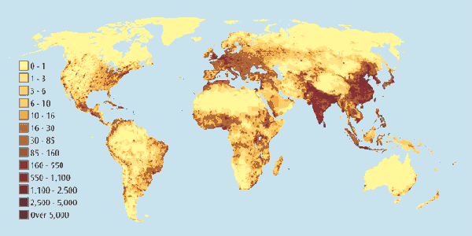
Visual dimension: value
Encode information using how dark the mark is drawn
Example:

Slide 53
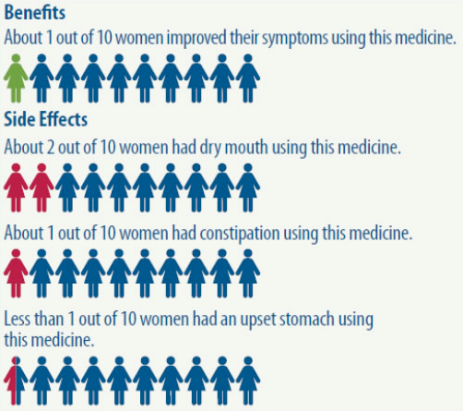
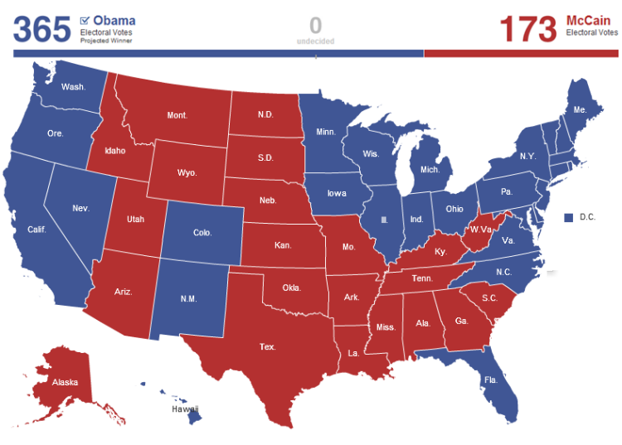
Visual dimension: color
Encode information using the hue of the mark
Examples:

Slide 54
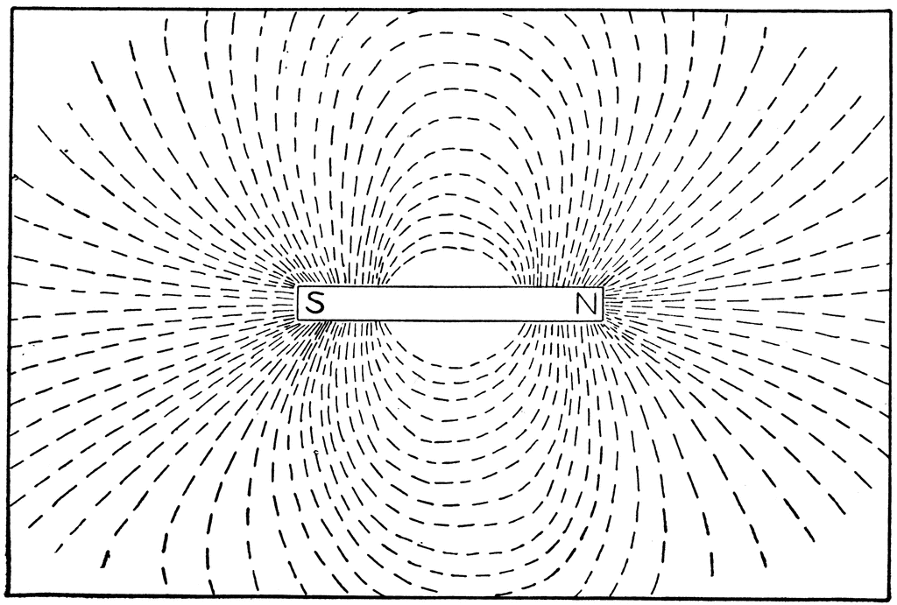
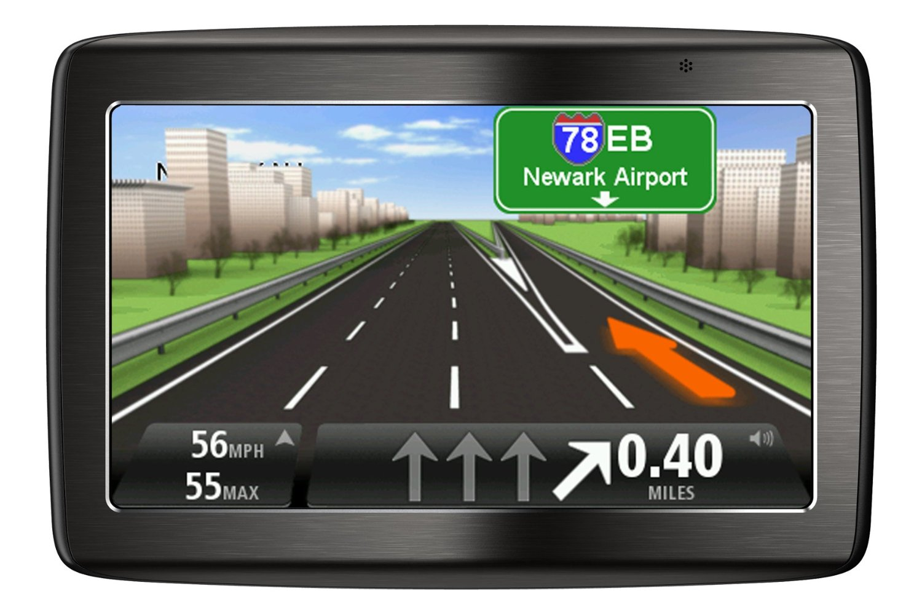
Visual dimension: orientation
Encode information using how the mark is rotated
Examples:

Slide 55



Visual dimension: shape
Encode information using how the mark is shaped
Examples:

Slide 56
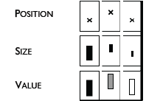
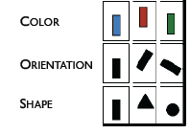
Discussion: visual dimensions & data type
Categorical Numerical
Jacques Bertin, Semiologie Graphique (Semiology of Graphics), 1967.

Slide 57
Pre-lunch activity: deconstructing graphics
Find a data visualization you think is interesting
Some ideas: NYTimes, VisualisingData.com, Visual.ly
Remember to cite your source!
Identify the following:
What is the data that’s being visualized? Where did it come from?
Which data dimensions are mapped to which visual dimensions?
How does this shape your understanding of the data?
If you liked the visualization: what is it doing well?
If you disliked the visualization: what would you change?

Slide 58
Discussion
What makes a good encoding?

Slide 59
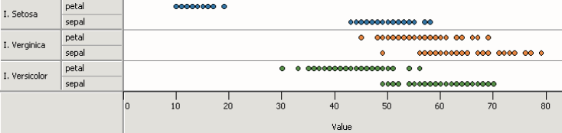




Principle 1: expressiveness
Encodes all the facts
Example:
Fig. Courtesy of M Krzywinski

Slide 60
Principle 1: expressiveness
Encodes only the facts
Example:
Adapted from Mackinlay J (1986) Automating the design of graphical presentations of relational information.

Slide 61

Principle 2: consistency
Use consistent axes when comparing charts
Raina SZ, et al. (2005) Evolution of base-substitution gradients
in primate mitochondrial genomes. Genome Res 15: 665-673.
M. Krzwinski, behind every great visualization is a design
principle, 2012

Slide 62



Principle 2: consistency
A note on legends: order items according to appearance
M. Krzwinski, behind every great visualization is a design principle, 2012

Slide 63




Principle 2: consistency
Visual variation should reflect and enhance the underlying variation in the data
Avoid visually similar encodings for independent variables
Example:

Slide 64


Principle 2: consistency
Uniform size and alignment reduces visual complexity and aids interpretation
Example:
Fig. 1: Sharov AA et al. (2005) Genome-wide assembly and analysis of alternative transcripts in mouse. Genome Res 15: 748-754.
Fig. 2: M. Krzwinski, behind every great visualization is a design principle, 2012

Slide 65

Tufte, 1983
“Above all else, show the data.”

Slide 66
Tufte, 1983

Slide 67


Tufte: maximize the data-ink ratio

Slide 68

Familiar example

Slide 69
Discussion
What do you think of the data-ink ratio?
Consider ways to maximize it…

Slide 70


Principle 3: importance ordering
Avoid unnecessary containment and repetition
Example

Slide 71


Principle 3: importance ordering
Navigational aids shouldn’t compete with data
Avoid: heavy axes, error bars and glyphs
Heer J, Bostock M (2010) Crowdsourcing graphical perception: using mechanical turk to assess visualization design.
Proceedings of the 28th international conference on Human factors in computing systems. Atlanta, Georgia, USA: ACM. pp. 203-212.

Slide 72


Principle 3: importance ordering
Simplify, simplify, simplify…
Sharov AA, et al (2006) Genome Res 16: 505-509.
Peterson J, et al. (2009) Genome Res 19: 2317-2323.
Thomson NR, et al. (2005) Genome Res 15: 629-640.
DB, Ko MS (2005) Genome Res 15: 748-754.
M. Krzwinski, behind every great visualization is a design
principle, 2012

Slide 73


A caveat: “chart junk” and recall
Bateman et al. “Useful Junk? The Effects of Visual Embellishment on Comprehension and Memorability of Charts”, CHI 2010

Slide 74


Chart junk and eye gaze

Slide 75
After lunch
Mini-lecture and lab: building data graphics with ggplot2
TODO (if you haven’t already):
> install.packages(‘ggplot2’)

